Slide 1
Department of ECE
EMBEDDED PROTOTYPE
IoT-Based Smart Health Monitoring System
GUIDED BY:-
Dr.N.PRABAKARAN Associate Professor Dept of ECE
PRESENTED BY:-
K. PARDHU(2300049078)
K.SAI CHARAN(2300049092)
G.VARSHITH(2300049093)

Slide 2
Objective
To develop a portable IoT-based system that continuously monitors vital health parameters (heart rate, SpO₂, and body temperature) in real time and remotely alerts caregivers in case of abnormal conditions.
Continuous real-time monitoring of vital parameters such as heart rate, oxygen saturation (SpO₂), and body temperature using sensors connected to the ESP32.
Early detection of abnormal health conditions with automatic alerts/notifications for quick medical response and improved patient safety.
Development of a low-cost, portable and battery-powered smart healthcare device that reduces hospital visits and supports home-based patient care.

Slide 3
Problem Statement
Patients, especially elderly and chronically ill, need continuous monitoring of vital signs, but regular hospital visits and manual checking are costly and time-consuming. Hence, a low-cost IoT-based system is required to monitor health parameters in real time and remotely alert caregivers during abnormal conditions.
Continuous manual monitoring is difficult, and delayed detection of abnormal vital signs can risk patient safety; therefore, a real-time remote health monitoring system is required.

Slide 4
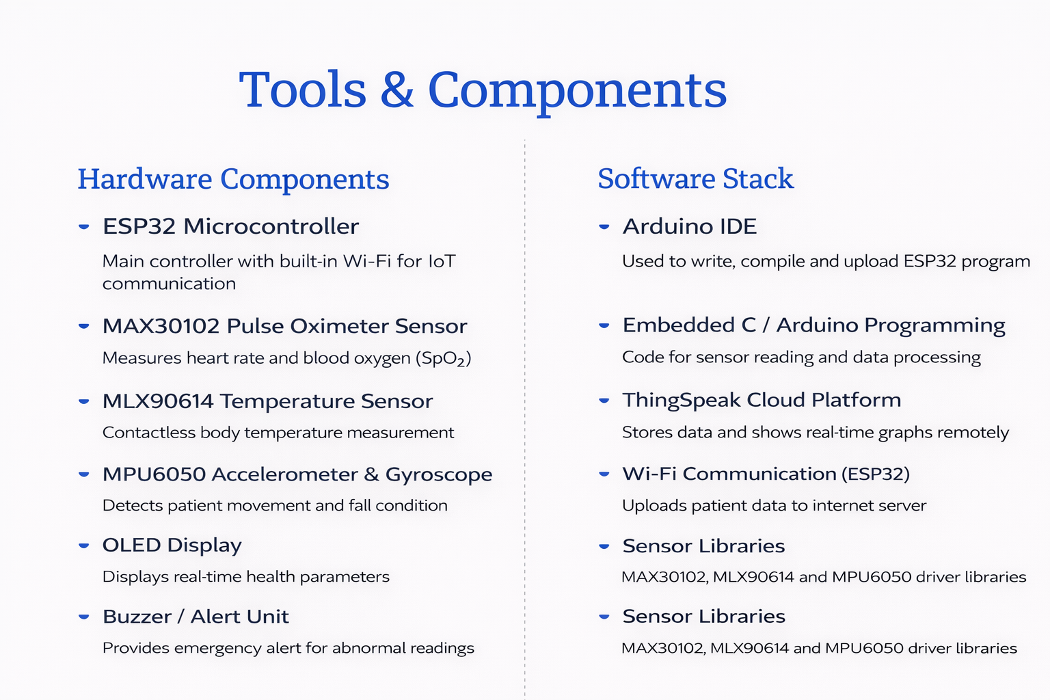
TOOLS TO BE USED FOR HARDWARE AND SOFTWARE

Slide 5
BLOCK DIAGRAM
SpO₂&Heart Rate sensor
(MAX30102)
ESP32
OLED Display
Body
Temparature sensor
(MLX90614)
Buzzer/Alert
Motion Sensor Module
(MPU6050)
Thingspeak cloud Platform
Mobile Application
Battery+TP4065 Charging module

Slide 6





Methodology / Working
Sensor Detection
MAX30102, MLX90614 and MPU6050 continuously monitor patient vital signs and movement.
Data Processing
ESP32 reads and processes sensor data in real time.
Alert Generation
Buzzer alerts when abnormal values or fall condition is detected.
Cloud Upload
ESP32 sends data to ThingSpeak using Wi-Fi connection.
Remote Monitoring
Doctor/caretaker can view live health readings from anywhere.

Slide 7
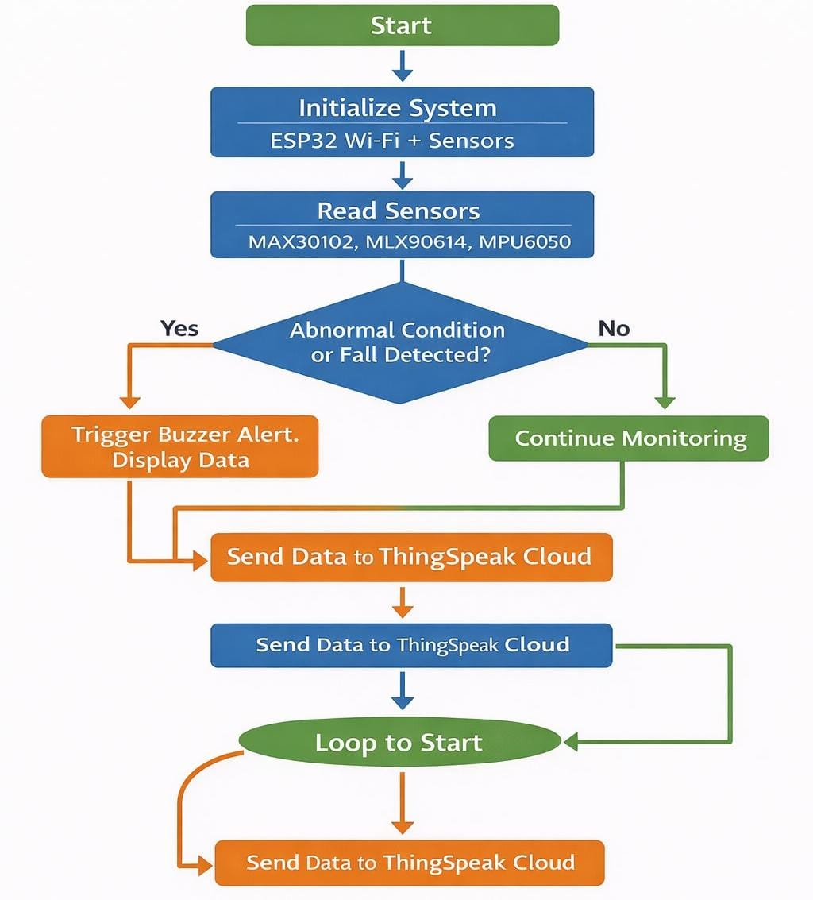
Flowchart

Slide 8
Conclusion & Future Scope
CONCLUSION :
• Real-time monitoring of heart rate, SpO₂ and body temperature. • Data uploaded to ThingSpeak cloud for remote doctor access. • Alert and fall detection improves patient safety and care.
Future Scope
• Add SMS / mobile notification for emergency situations. • Integrate advanced sensors like ECG and blood pressure. • Develop mobile app with AI-based health prediction.

Slide 9

THANK YOU
EMBEDDED PROTOTYPE

